Slide 1
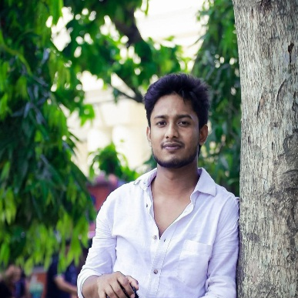







AHASAN HABIB
+8801783299492
ROXY
ahasanstu@gmail.com
Ahasan habib Roxy
WEB DEVLOPER
Ahasan habib Roxy
BSC
Geography and Environment Science
National University
2017 to running..
HSC
GPA- 4.42
Sos Hermann Gmeiner College, Bogura
(2015 To 2017)
Education
SSC
GPA- 5.00
Osmanpur High School
(2013 To 2015)
JSC
GPA- 4.64
Osmanpur High School
(2015 To 2017)
Content Creator
At Youtube
(2017 To 2019)
Computer Opeator
Saiful Compurter
(2020 To 2021)
Experience
Digital Marketer
At Facebook
(2017 To 2021)
Freelancer
At Fivver
(2018 To 2021)
Web Developing
Skill
Graphic Design
Microsoft Office
Photoshop
After Effects
Premier Pro
Premier Pro

